Slide 1
NPV & Capital Budgeting
Read NPV & CAPITAL BUDEGETING

Slide 2

NPV and Investment Decisions
If NPV < 0, project worth is greater/equal/less than the cost
You should invest/decline/be neutral about the project
If NPV > 0, project worth is greater/equal/less than the cost
You should invest/decline/be neutral about the project

Slide 3
Pharmco Project in Calculator
In millions
-1000 CF0
150 CF1
180 CF2
216 CF3
259.20 CF4
811 CF5
8 I/YR
2nd Fct NPV
NPV = 207.15 Million
Accept this project. It is expected to create value for the firm. Announcement of the project will lead to increased stock value.

Slide 4
Guided Example (con’t)
(2) What is the risk-adjusted discount rate (k)? Why?
It is the firm’s required rate of return or hurdle rate. This rate adjusts for the risk of the project. If this project does not return 8% or higher, put the funds elsewhere.
(3) What is the risk premium for this investment? = rate – risk-free = 8% - 4% = 4%
(4) Find PV for investment. NPV = $207.15
(5) Should you invest / reject? You should invest. This project is expected to create $207.15 M of value. The market should react positively to the announcement of this project. Some analysts may well include positive information about this project in their reports and the stock price should increase.

Slide 5
Today is January 1 2010
-1260 CF0
250 CF1
270 CF2
290 CF3
310 CF4
330 CF5
4+6.6 = 10.6 I/YR
2nd Fct NPV
NPV = -192.30
Reject or decline this project. You would not invest as investing would destroy value for the firm.

Slide 6
Examples
(1) Can an adjusted risk-free rate be lower than the risk-free rate? Why?
No. Higher risk requires a positive risk premium.
(2) NPV = $-192.30
No, don’t Invest. Reject the project. You would destroy value. If you announced that you were planning to invest in this project despite the fact that projected cash flows in the future were too low to justify the cost, then analysts then some analysts would likely write negative reports. They could mention that the returns are too low, the costs are too high, or the risks are too high. The stock price would likely fall.

Slide 7
NPV of an Investment Project with initial Investment of $5 M
-5 CF0
1,6 CF1
-2,4 CF2
7.8 CF3
Careful: Year 2 requires another round of investment
12 I/YR
2nd Fct NPV
NPV= .067*1,000,000 = 67,192.07
This is a valuable project. Year 0 and Year 2 investments are worth it. Invest / accept this project.

Slide 8
Consider Projects A and B; Mutually Exclusive (Go with A)
Project A
-100 CF0
200 CF1
8 I/YR
2nd Fct NPV
NPV = 85.19
Less risky, accept
Project B
CFs are the same
16 I/YR
2nd Fct NPV
NPV = 72.41
Good but reject, does the same as A, mutually exclusive

Slide 9
Pharmco Project in Calculator IRR this time
In millions
-1000 CF0
150 CF1
180 CF2
216 CF3
259.20 CF4
811 CF5
2nd Fct IRR
IRR = 13.7%
13.7% > 8% discount rate
Accept this project. Its return or IRR is higher than the discount rate / hurdle rate. It creates value for the firm. Answer- always run NPV to be sure.

Slide 10
Problems with IRR: Two IRRs if Sign Change in CFs, use NPV
-170 CF0
160 CF1
CF2
CF3
CF4
-520 CF5
2nd Fct IRR
Tells you just one of two IRRs, 6.77%
but there are two … the other one is 65.36%
IRR above or below 8%?
Answer, run NPV at 8%
NPV = 6.04 Accept

Slide 11
Reinterpret IRR: If company is being paid to accept project
+1000 CF0
-150 CF1
CF2
CF3
CF4
CF5
I/YR = 8%
NPV at 8%: 401.09
NPV at 5%: 350.58
Check IRR: = -8.9%
In this case the firm is being paid 1,000 upfront to take on a future liability.
Answer: Run the NPV.

Slide 12
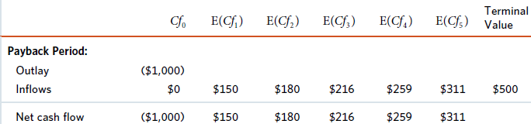
Problems associated with Payback Period
Ignores risk and time value:
$100 five years from now is worth the same as $100 one year from now according to the payback period method
You don’t need to account for the difference in riskiness amongst projects
Over-simplified the problem
Consider the Pharmaco example again:
The pay back period is __5_ years. If executives set a 3 year payback rule, they would accidentally reject a project that creates a lot of value.
Cumulative CF | -1000 | -850 | -670 | -454 | -195 | 116

Slide 13
Examples to Check understanding of IRR, NPV, and Payback
(1) Does IRR rule always lead to the same decision as the NPV rule? Why?
The IRR works nearly all the time, in that it leads to the same decision as the NPV. Also, it is intuitively appealing to see an IRR that is above the hurdle rate.
Still, there are occasional cases when there are multiple IRRs or when the IRR rule is reversed. Also, the IRR does not indicate the scale of the project. When it evaluating which mutually exclusive project to accept, the NPV is preferred.
(2) Given the following cash flows, should you invest/ not invest based on IRR?
See next page.
Year 0 | Year 1 | Year 2 | Year 3
($2,340) | $200 | $440 | $770

Slide 14
Given the Following CFs, should you invest based on IRR
-2340 CF0
200 CF1
440 CF2
770 CF3
I/YR = 8%
NPV = -1,166.33
IRR = -18.64%
Reject this project.
No matter what the discount rate is the IRR is negative so it is less than the discount rate.
Accepting would destroy value.

Slide 15
OPTIONAL: CFs reversed, IRR rule reversed
+2340 CF0
-200 CF1
-440 CF2
-770 CF3
I/YR = 8%
Careful. CFs are “backwards” in that the company gets paid upfront. so IRR rule is “backwards” or flipped too.
NPV = +1,166.33
IRR = -18.64%
The NPV is positive.
The rule in this case is “backwards”, the IRR < discount rate means accept.

Slide 16
Given the Following CFs, risk free rate = 4%, risk premium = 2.9%
-1550 CF0
610 CF1
390 CF2
790 CF3
Hurdle rate
= 4 + 2.9 = 6.9
NPV = 8.59 >0
IRR = 7.19%
Accept this project.
The IRR > discount rate / hurdle rate.
7.19 > 6.9
And,the NPV must be positive.

Slide 17
Examples (Arbitrary Payback of 4 Years)
(5) Given the following cashflows of a project and a target payback period of 4 years, based on payback rule should you accept/ reject the project?
-4460 + 1200 = -3,260 + 1430 = -1830 +550 = -1,280 +860 = -420 +3500 = 3,080
So early in year 5 the project is paid back; if management capriciously set a 4 year payback limit or target, they would reject this project even if it turns out to create a great deal of value.
(6) Assume same cashflows from question 5 and assume 10% required return, should you accept/ reject the project based on IRR rule?
NPV at 10% = 986.57 > 0
IRR = 17.08% > 10%
This project is very valuable and should be undertaken.
Year 0 | Year 1 | Year 2 | Year 3 | Year 4 | Year 5
($4,460) | $1,200 | $1,430 | $550 | $860 | $3,500

Slide 18
What is the IRR for this Project? Should it have been accepted?
-4460 CF0
1200 CF1
1430 CF2
550 CF3
860 CF4
3500 CF5
Hurdle rate = 10%
IRR = 17.08% > 10%
Accept this project based on IRR. The IRR > discount rate / hurdle rate.
The NPV = 986.67 >0.
Accept. This project would create a lot of value.

Slide 19
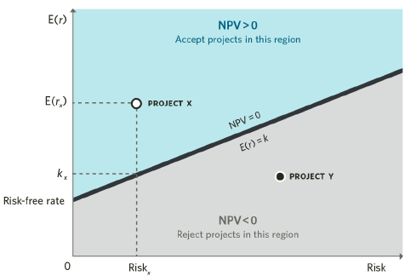
Investment Projects Plotted According to Expected Return and Risk
Here is a plot of return vs hurdle rate for projects.
For some companies, all projects have similar risk.
For other companies, project vary in risk– some are low, some are medium, some are high.
The black line -- The higher the risk of the project, the higher is the hurdle rate.
The black line– also the zero-NPV line.
You would accept/reject projects above the zero-NPV line and accept/reject projects below the zero-NPV line

Slide 20
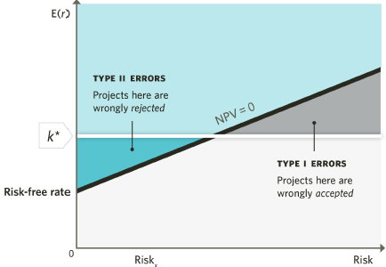
What if a Company uses a Single Discount rate when it should use Multiple Discount rates?
What are the consequences of using a single hurdle rate in evaluating all projects?
Suppose a single hurdle rate K* is used for all projects when projects have differing risk levels
Type I errors: wrongly accepted projects that would destroy value since required expected return is lower than discount rate
Type II errors: wrongly rejected projects that would actually create value since required expected return is higher than discount rate

Slide 21
Extra Example – Different Projects may have different DR
Suppose your company SNC is considering doing business with a high risk customer. The customer has a 50% chance of bankruptcy in which case some Accounts Receivable will never be collected. Your company average discount rate is 12%. The hurdle rate for low, middle, and high risk projects = 6%, 12% and 18%.
Your analyst runs the IRR and finds it is 14% so tells you to accept this project since it is above the average company discount rate of 12%.
You, as owner, remind the analyst that this is a high risk project and the hurdle rate for this project is 18%. You say reject this project because it actually destroys value.

Slide 22
Examples
(1) What is the relationship between a project’s expected return and required return (discount rate) supposing the NPV of the project is negative? Assume conventional cash flows.
If the NPV is negative, the expected return or IRR is less than the required return.
An IRR which is lower than the discount rate indicates value destruction.
(2) Consider two mutually exclusive projects:
project A has NPV = -150
project B has NPV = -200, which project would you accept?
Neither; Reject both projects since they both destroy value. If the company needs this machine or project, keep working on it.
(3) There are two mutually exclusive projects, which of the two would you accept? See next.

Slide 23
Project A and B are mutually exclusive projects. Run NPV, IRR
Project A (I = 12)
-3000 CF0
5000 CF1
Project B (I = 12)
-10,000 CF0
15,000 CF1
12 I/ YR
NPV Comparison:
A = 1464.29 B = 3392.86
IRR Comparison:
A = 66.67% B = 50%
Accept B, not A. Project B creates higher value. IRR does not show the scope of the project.

Slide 24
Budget Constraints
If capital is constrained
PI or Profitability Index helps us obtain the best sum of NPVs
Use PI to get started
Then at end switch to NPV

Slide 25
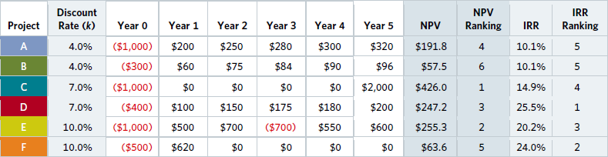
A Simple Fixed Budget Constraint
Fixed Budget Constraint: There are multiple projects with positive NPVs.
Consider the available projects below:
All the projects above have positive NPVs.
The total cost or upfront outlay is $4,200 in thousands or $4.2M.
Managers have a budget of only $2,000 in thousands or $2M.
Determine the projects you would invest in based on NPV rule. How many projects would you invest in and what is the value created by investing in these projects?
Invest in projects C, ranked 1 on NPV and E, ranked 2 on NPV. Cost = 1,000 + 1,000 = 2,000
You have hit budget constraint. Value created = 426 + 255.3 = $681.30

Slide 26
Profitability Index – Use at the beginning to allocate capital
Project D has the highest PI ranking at 1 cost = 400
Project C has the next highest PI ranking at 2 cost = 1,000
We cannot undertake project E (limited capital)
We can afford B or F
Pick the one with the highest NPV this time, F cost = 500
Project | Year 0 | NPV | NPV Ranking | PI | PI Ranking
A | ($1,000) | $191.8 | 4 | 0.19 | 4
B | ($300) | $57.5 | 6 | 0.19 | 4
C | ($1,000) | $426.0 | 1 | 0.43 | 2
D | ($400) | $247.2 | 3 | 0.62 | 1
E | ($1,000) | $255.3 | 2 | 0.26 | 3
F | ($500) | $63.6 | 5 | 0.13 | 6

Slide 27
Next Determine Which Projects to Pick
Based on the table you created, what projects would you invest in using PI?
First pick projects C and D. Then take the budget constraint and subtract the Costs of Projects C and D to see what you have left.
2000 budget – 400 – 1000 = 600
Do you have enough left over for Project E with the PI rank of 3? No
Do you have enough left over for Project A with the PI rank of 4. No
Next look at project B with a PI rank of 4 like A and also consider project F with a PI of rank of 6. (We skipped 5 since two of them tied.)
At this point, switch back from PI or efficiency of dollar outlay, and make sure that the PI does not conflict with the most important decision of NPV.
The NPV of B is 57.50 while the NPV of F is 63.60
So while PI helped us at the beginning when faced with a budget constraint, now we should pick project F.
Total NPV = D + C + F = 247.20 + 426 + 63.60 = $736.80 better than $681.30

Slide 28
Examples
(1) You are given two mutually exclusive projects X and Y with the same risk. The risk-adjusted discount rate is 14.9%. Which project would you invest in?
These two machines do the same thing. The NPV rule suggests project X. The IRR rule actually suggests project Y. Go with project X which creates higher value. Looking at IRR alone ignores scale.
(2) Find the profitability index for a project with the following cashflows and a discount rate of 10.5%
CF0 = -2040; CF1 = 760; CF2 = 220; CF3 = 400; CF4 = 680; CF5 = 280; I/YR = 10.5.
NPV = -$249.52 PI =- 249.52 / 2040 = -.12
Project | Outlay | Year 1 | NPV | IRR
X | ($34,000) | $40,000 | $426 | 14.9%
Y | ($18,000) | $21,500 | $255.3 | 20.2%
Outlay | Year 1 | Year 2 | Year 3 | Year 4 | Year 5
($2,040) | $760 | $220 | $400 | $680 | $280

